Slide 1
HPC for ML Magurele Summer School
GPU Accelerated Distributed Data Science
Marco Celoria – CINECA
Magurele 9 July 2025

Slide 2
Machine Learning
Machine Learning is building model from data using optimization.
High-dimensional non-convex optimization based on a growing wealth of data
Larger and larger training sets
GPUs used to speed up training times on such larger training sets
New learning algorithms optimize convergence and generalization

Slide 3
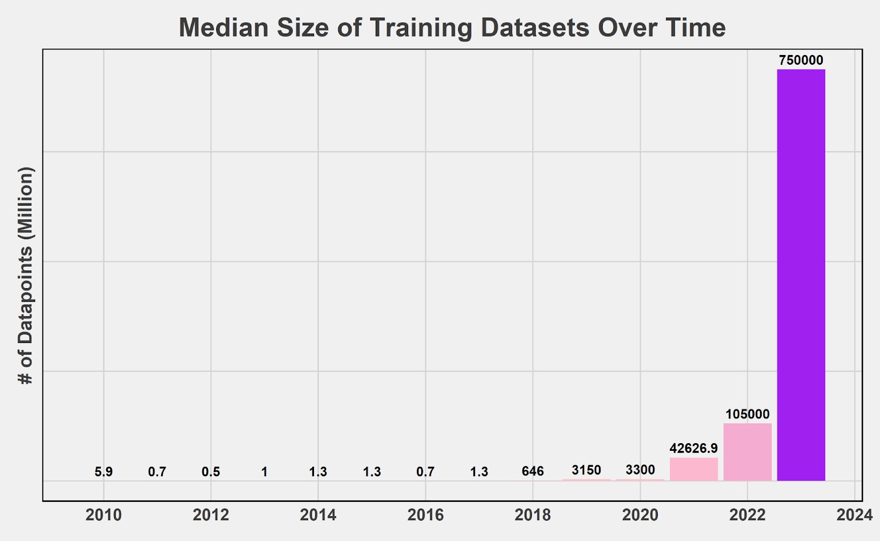
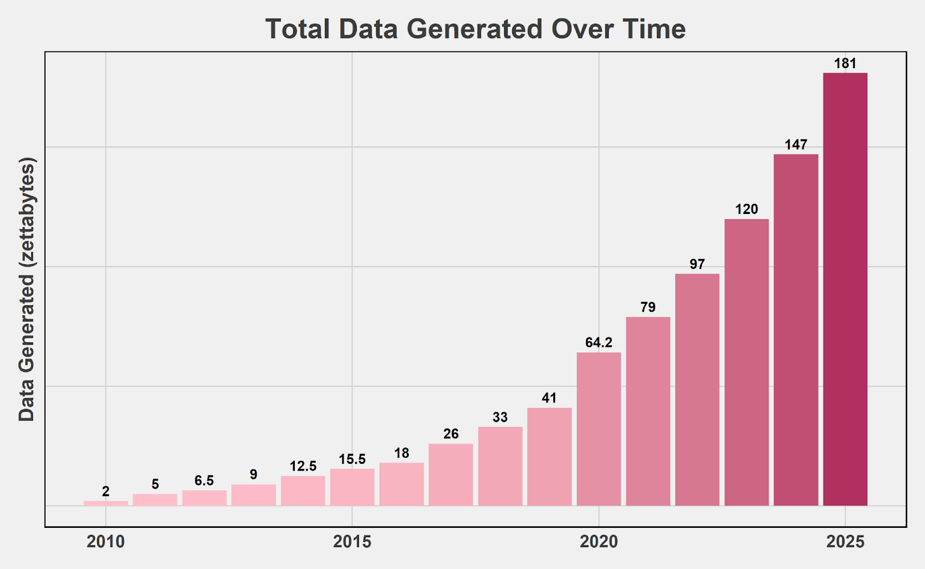
Machine Learning - Data
https://futuretech.mit.edu/news/what-drives-progress-in-ai-trends-in-data

Slide 4
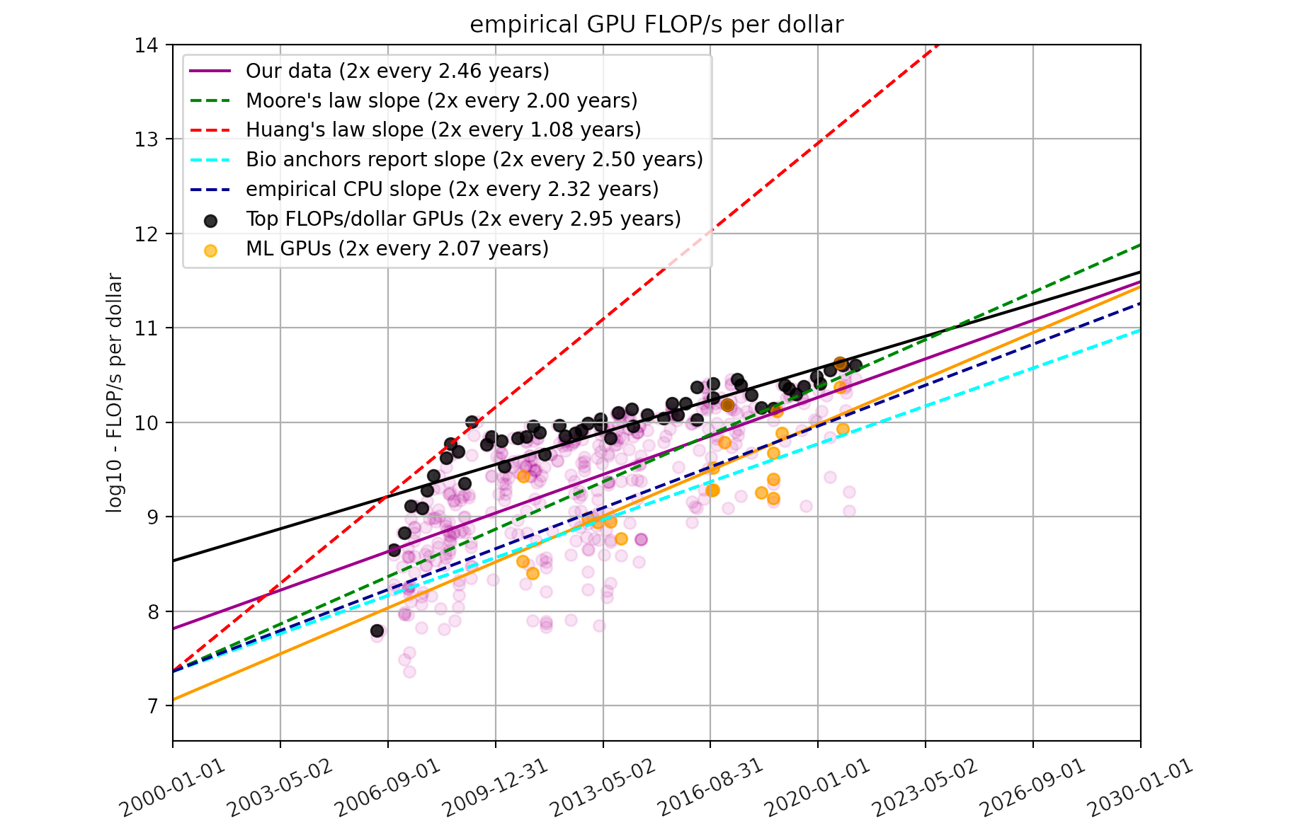
Machine Learning - GPUs
Marius Hobbhahn and Tamay Besiroglu, "Trends in GPU Price-Performance".

Slide 5
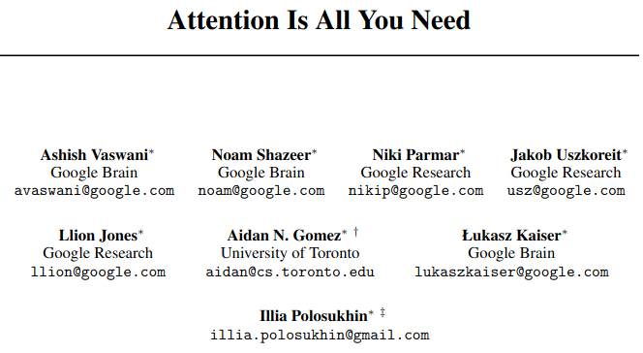
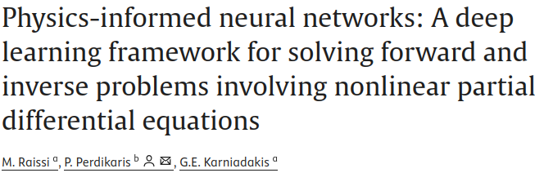
Machine Learning - Algorithms

Slide 6
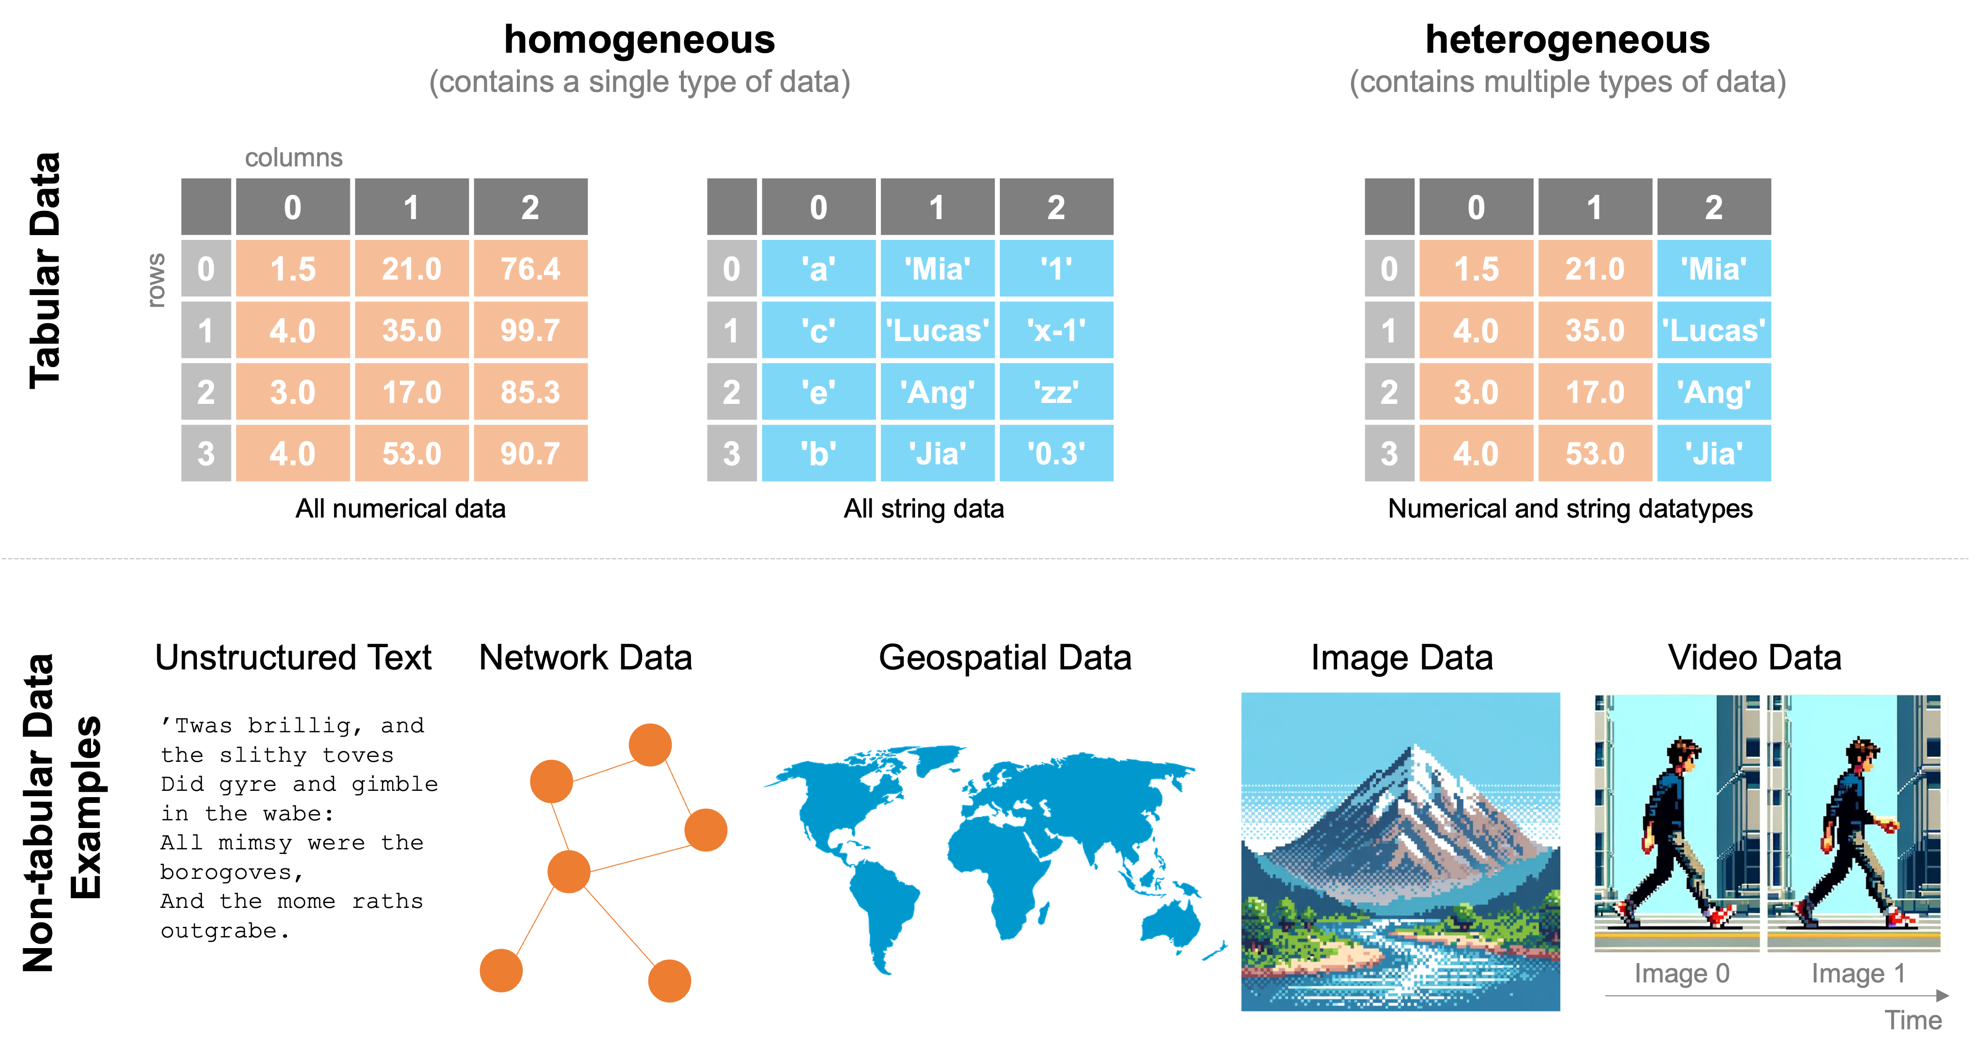
Type of data
https://www.practicaldatascience.org/notebooks/class_3/week_2/00_intro_to_pandas.html

Slide 7
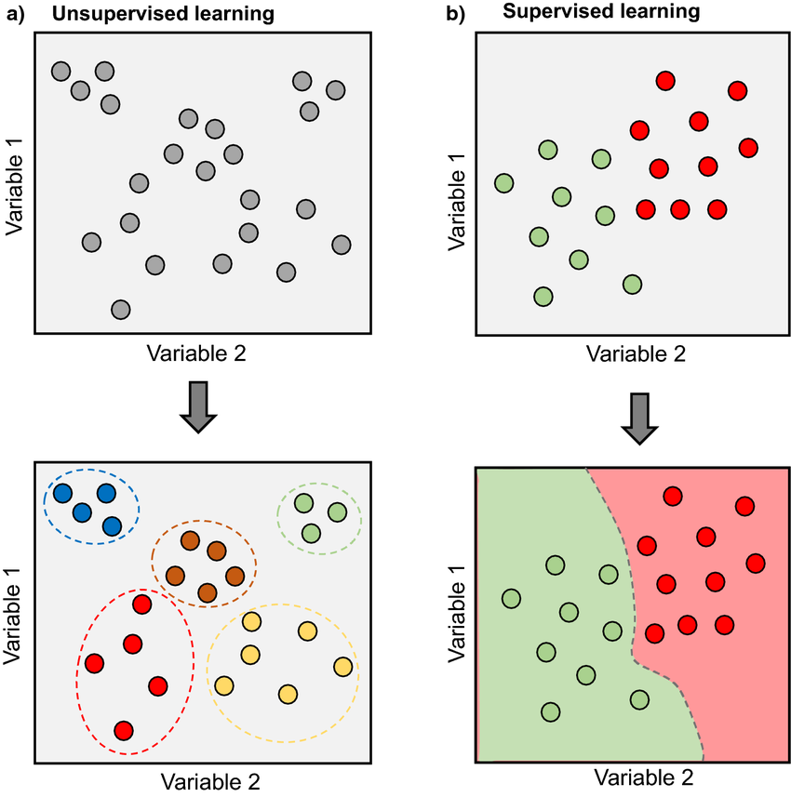
Supervised and unsupervised learning
Morimoto, Juliano & Ponton, Fleur. (2021). Virtual reality in biology: could we become virtual naturalists?

Slide 8
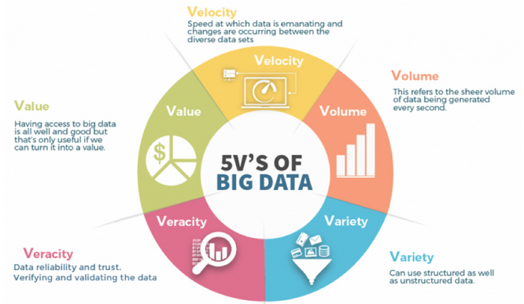
Big Data
A 2018 definition states "Big data is where parallel computing tools are needed to handle data" [Fox, Data Science for Transport]
https://www.devopsschool.com/blog/what-is-big-data-processing-tools-and-use-cases-of-big-data-processing-tools/

Slide 9
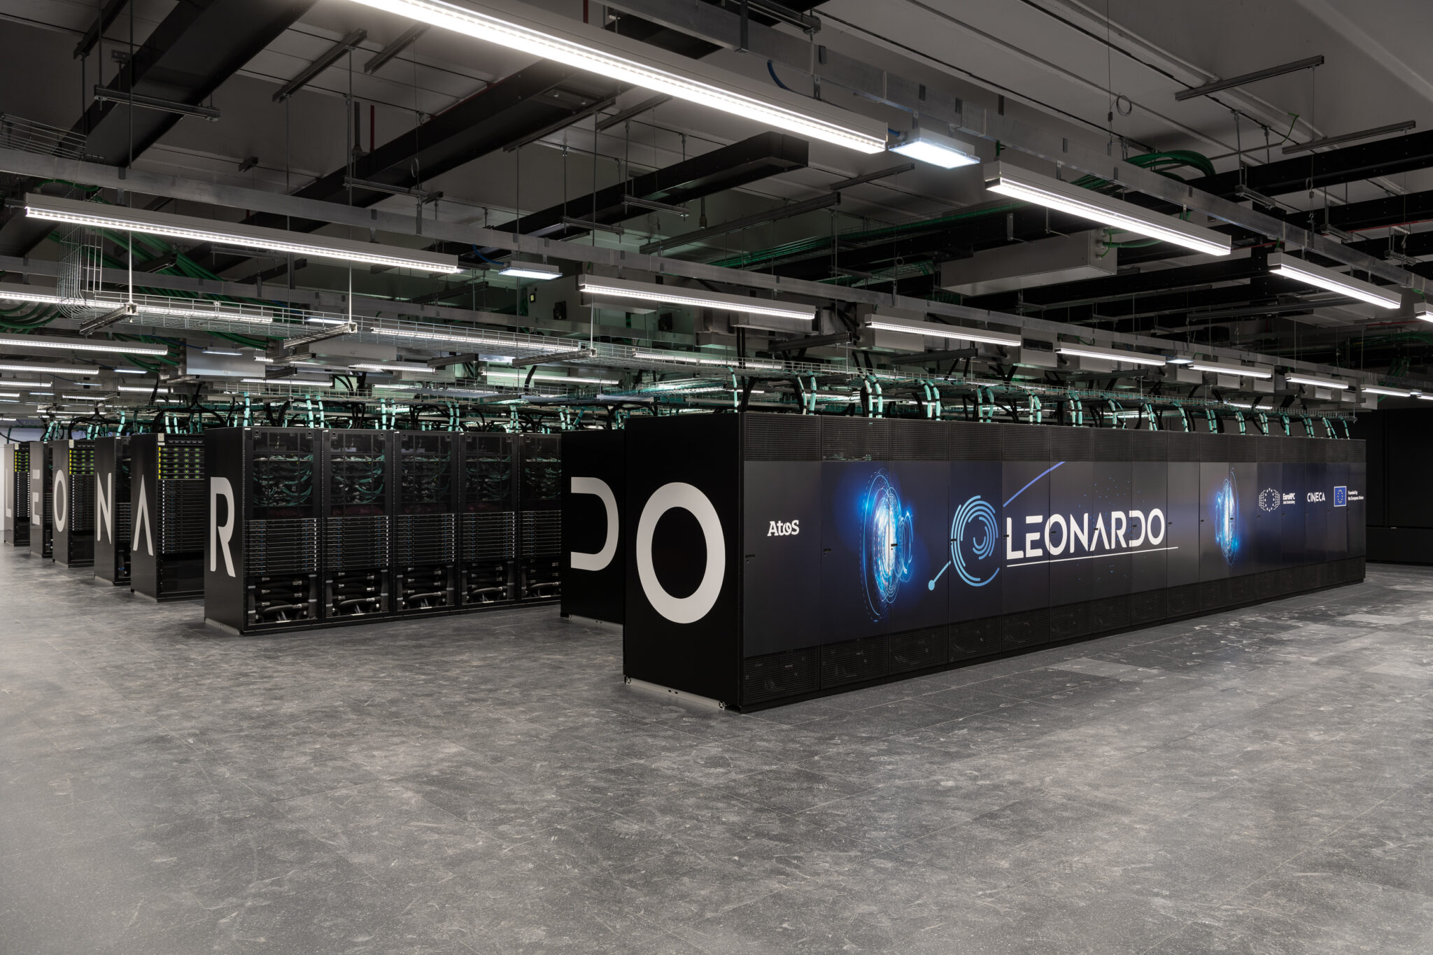
Hardware limitations
On Leonardo, we have Lustre (open-source parallel filesystem) and the High Performance Storage is 5.7 PB (DDN Exascaler ES400NVX2)
RAM of the compute node is 512 GiB
Big data cannot fit in the memory of a computational node
Most Pandas operations run on a single thread, while some scikit-learn estimators and utilities are parallelized using multi-cores CPU

Slide 10
Feature of Big Data Processing Tools
Distributed Computing: Big Data Processing Tools distribute data and computation across multiple nodes or clusters to achieve scalability.
Fault Tolerance: They provide mechanisms to handle node failures and ensure data integrity.
Parallel Processing: Tools leverage parallel processing techniques to speed up data processing tasks.
Data Replication: Data replication ensures data availability and resilience.
Data Partitioning: Tools partition data for efficient processing and distribution across the cluster.
Data Compression: Compression techniques reduce storage and transmission overhead.

Slide 11
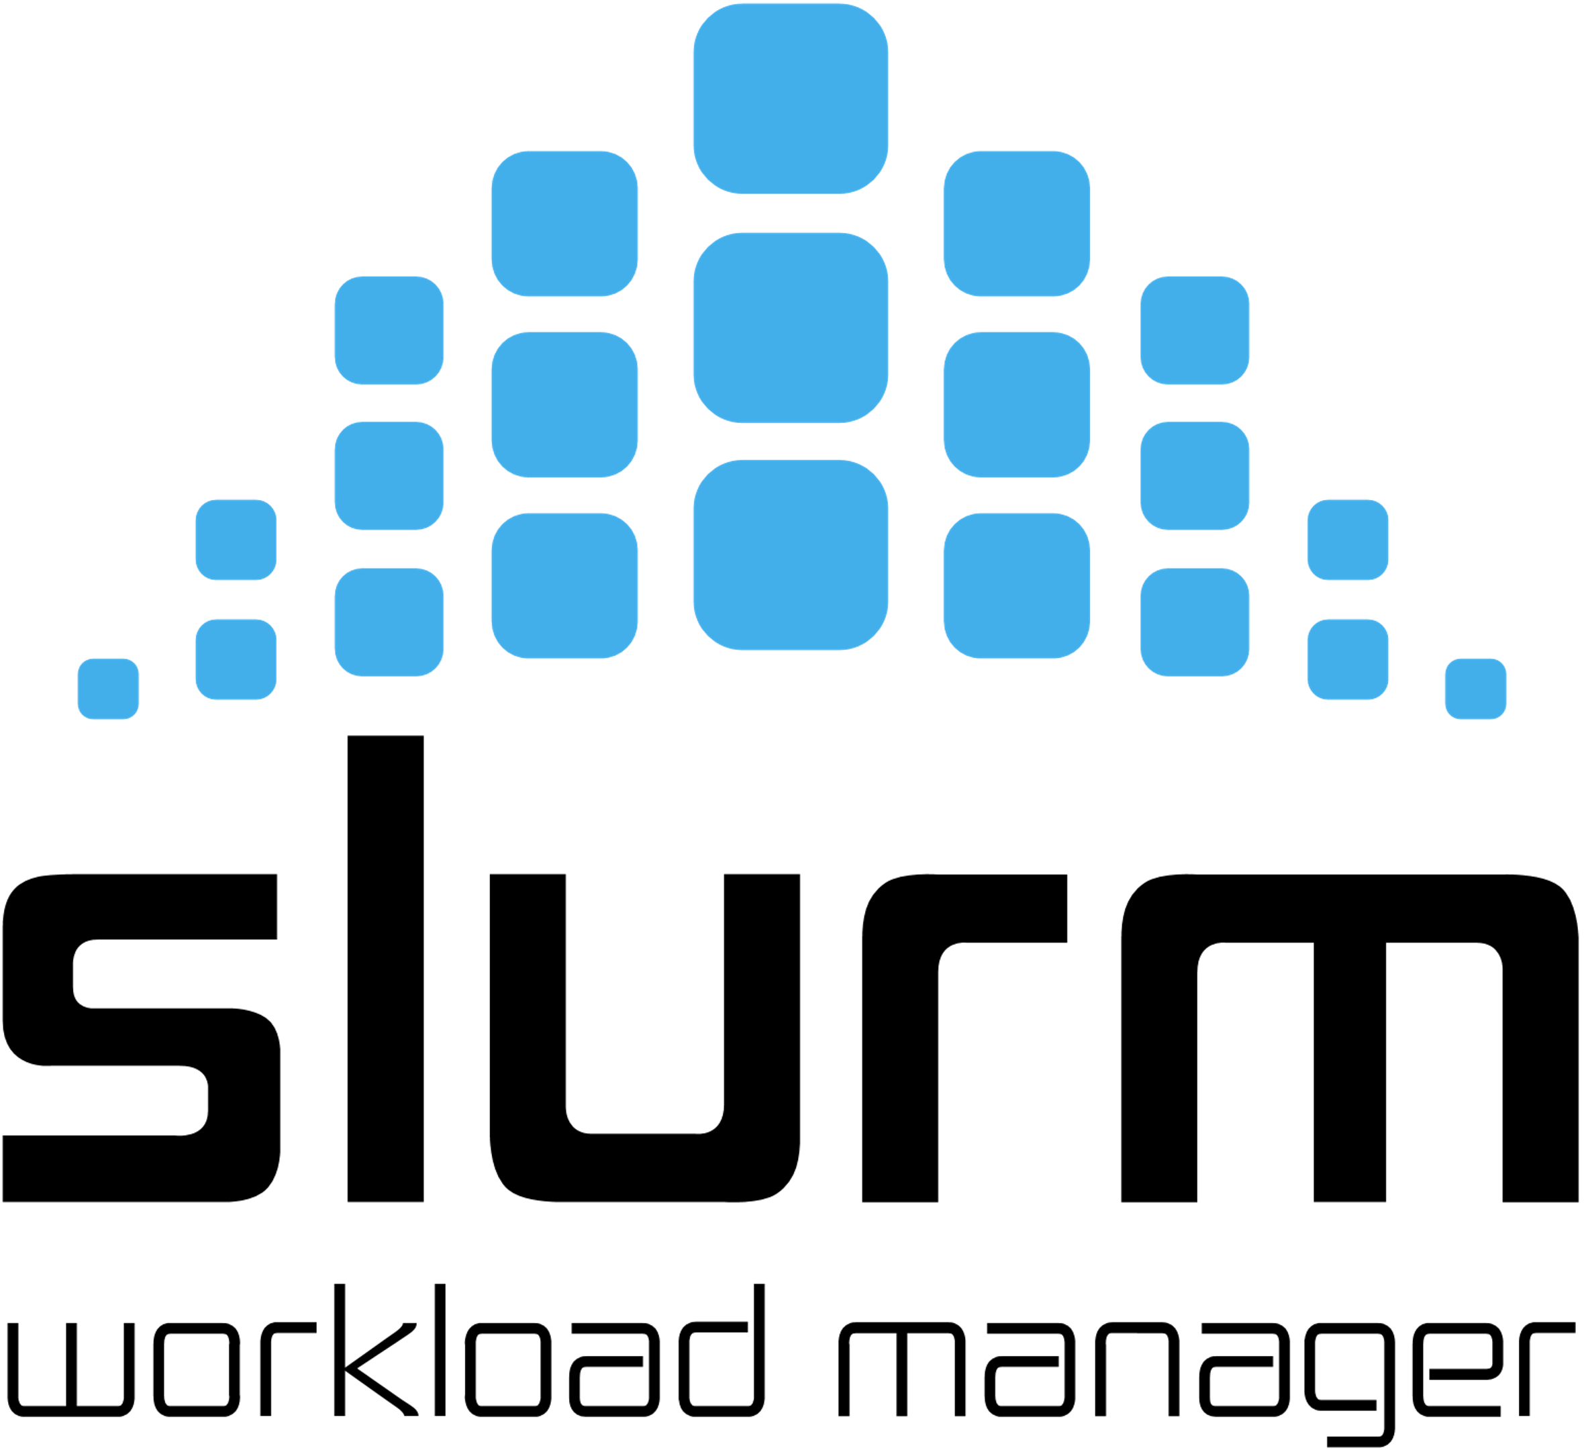
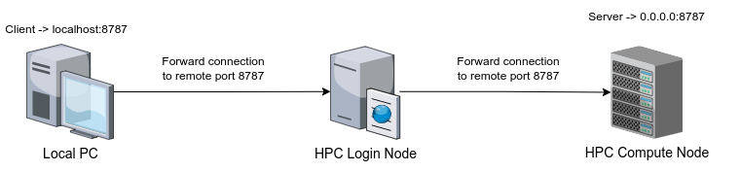

HPC infrastructure
Login nodes are the only nodes accessible from external networks.
On Leonardo no connections from the computational nodes to the outside world are permitted.
To use interactive tools like Jupyter Notebook using the client-server paradigm in HPC compute nodes:
Finally, we typically use SLURM as the job scheduler

Slide 12



Coud infrastructure
By containerizing the model with Docker and orchestrating it with Kubernetes, we can ensure consistency, scalability, and reliability
The key principles in modern MLOps workflows.
Kubernetes clusters can deploy, manage, and scale AI and ML:
Infrastructure orchestration that supports GPUs for training at scale.
Flexible integration with distributed computing and data processing

Slide 13



Distributed DataFrames
The idea is to use the memory of several computational nodes that share the filesystem and communicate via the network
In addition, we parallelize the work on several multicore nodes
The most popular frameworks for distributed computing are
Apache Spark
Ray
Dask

Slide 14
What is Dask?
Dask provides multi-core and distributed+parallel execution on larger-than-memory datasets
Dask allow to work with larger datasets making it possible to parallelize computation
Dask is in Python and scales NumPy, Pandas, and scikit-learn.
Dask is a framework for parallelizing most Python objects.

Slide 15
When Dask?
Dask is not helpul for small size datasets as it generates overhead
Dask might be useful for medium size dataset as it allows to work in parallel on a local multi-core (or multi-GPU) machine.
Dask is essential for large datasets as Pandas, NumPy, and scikit-learn are not inherently built to operate on distributed datasets.

Slide 16
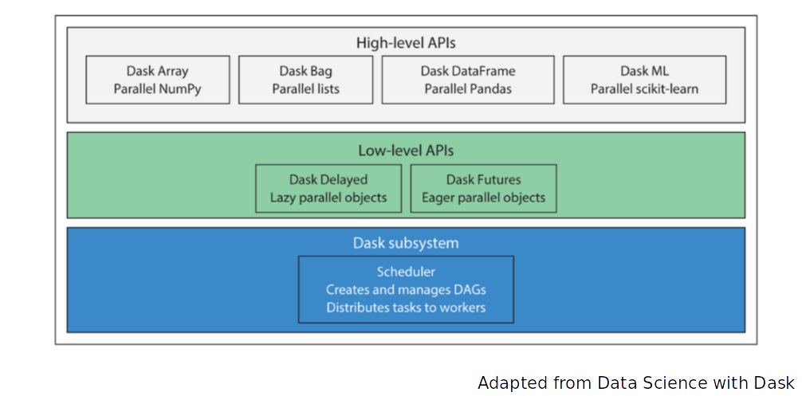
Dask APIs

Slide 17
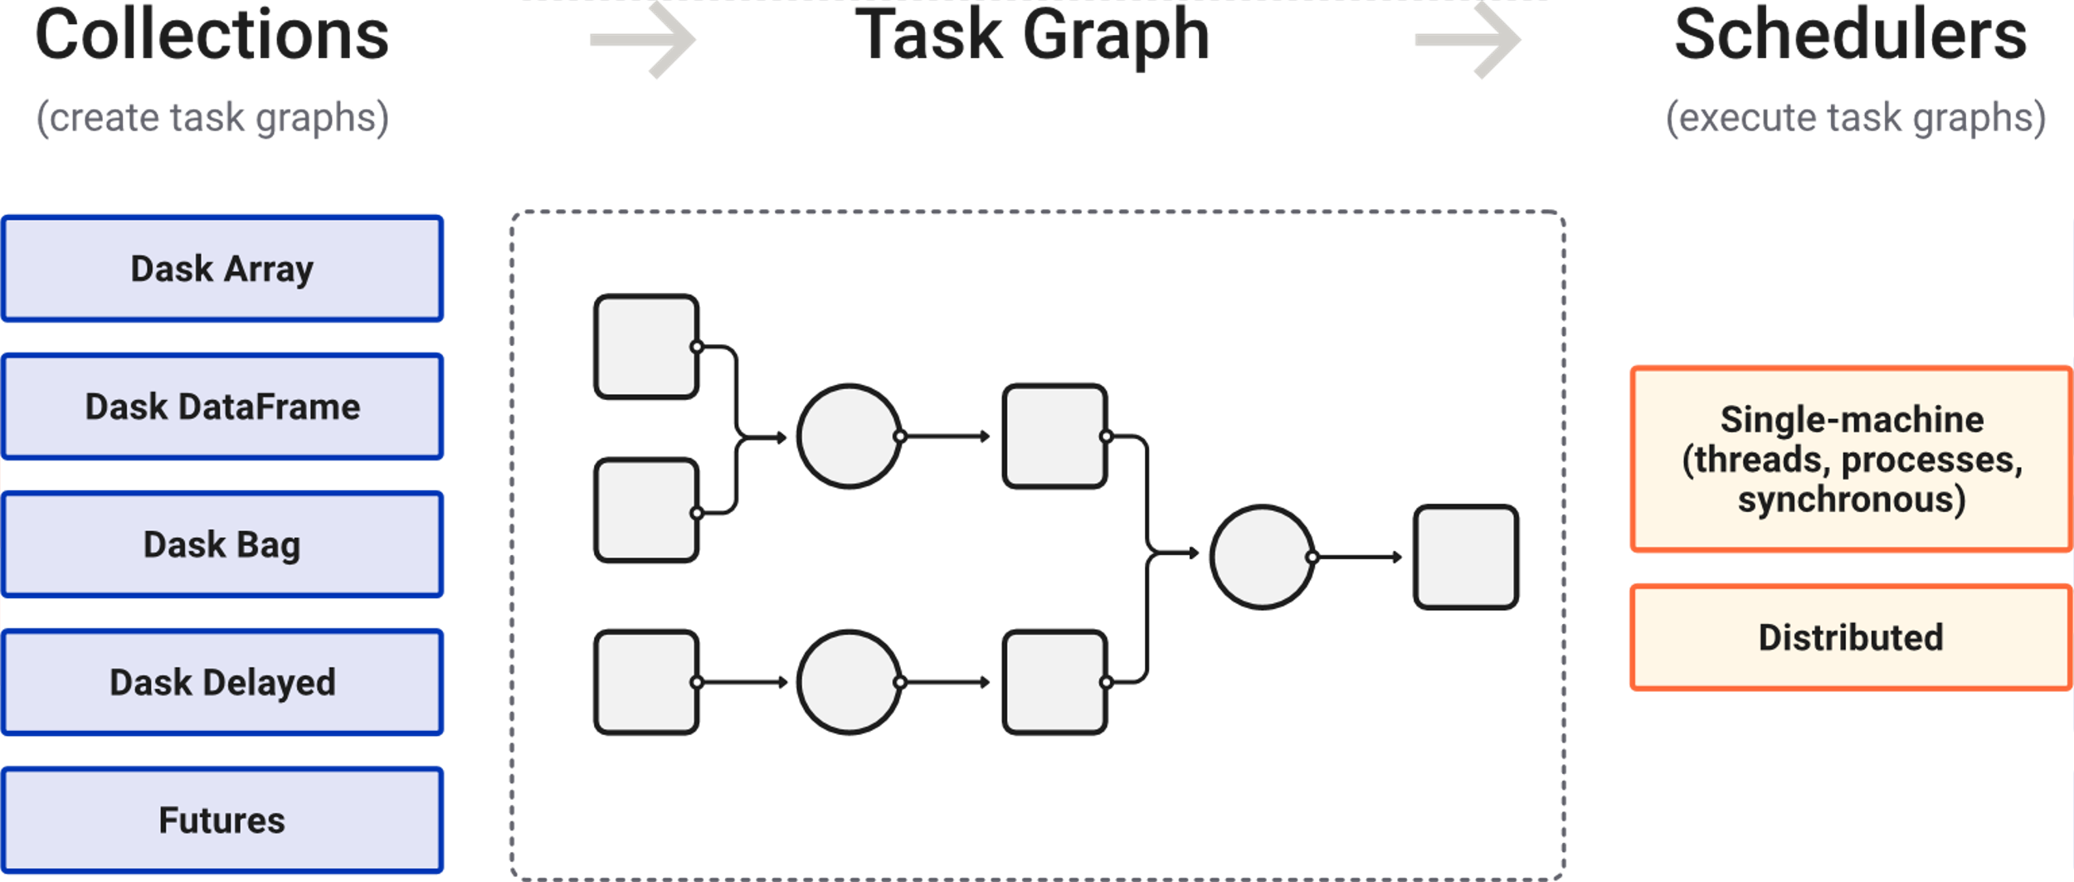
Dask overview
High level collections are used to generate task graphs which can be executed by schedulers

Slide 18
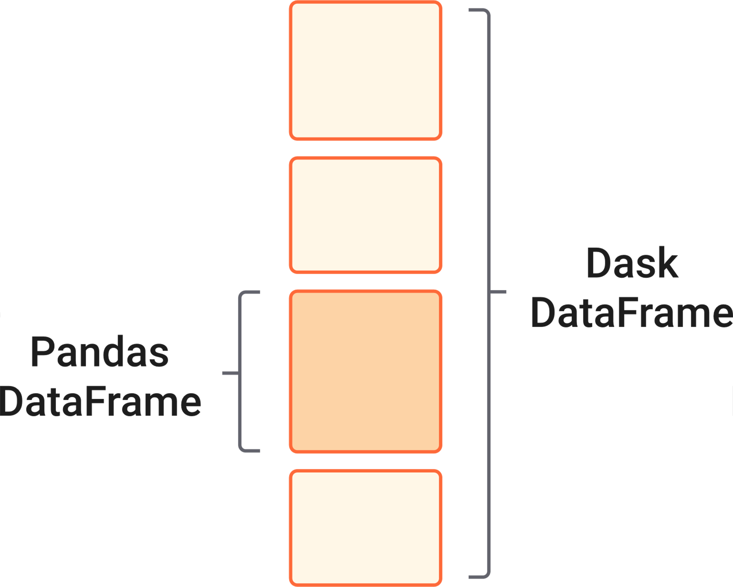
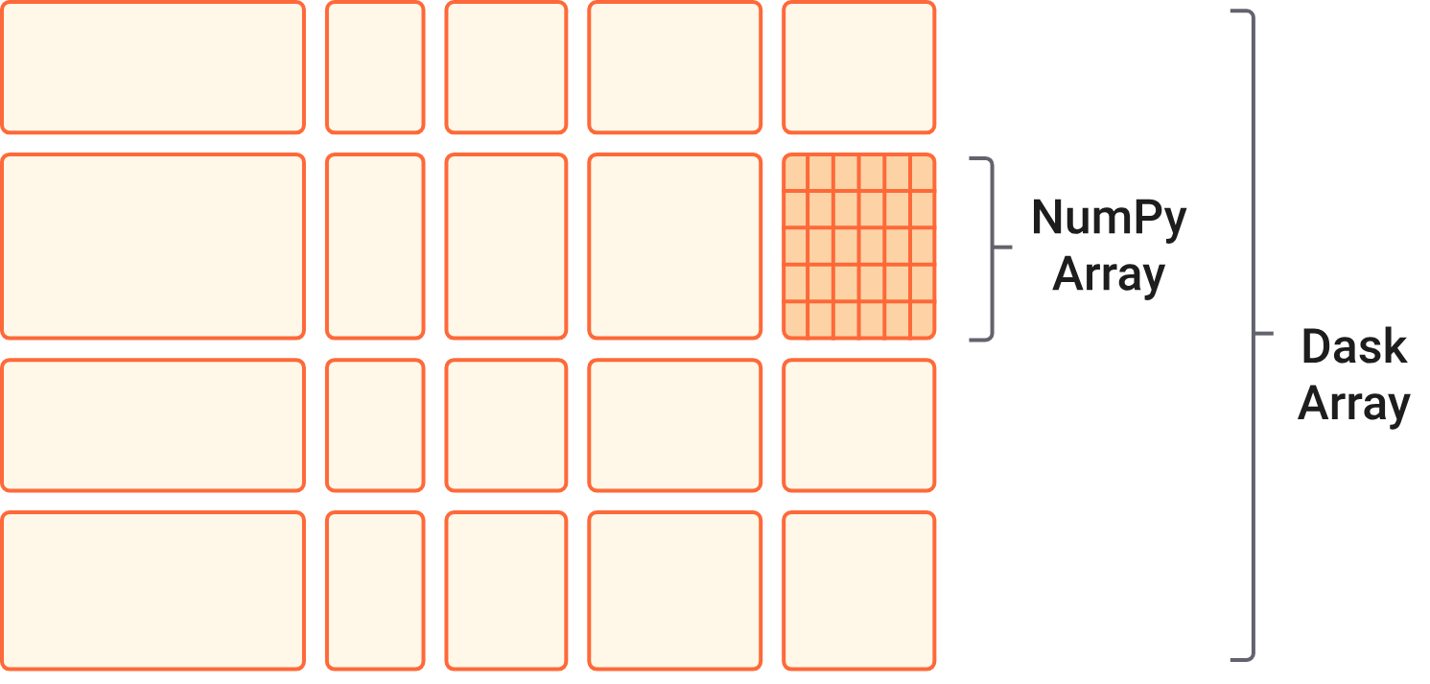
Dask Collections
Dask can be used to scale popular Python libraries such as Pandas and NumPy allowing to analyze dataset with greater size

Slide 19
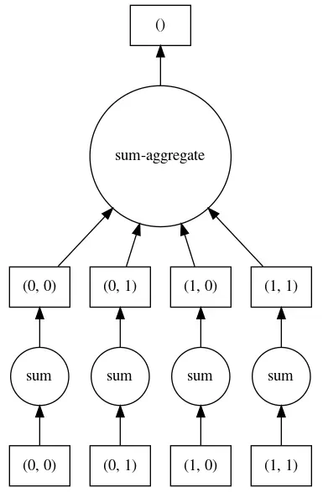
Task Directed Acyclical Graph (DAG)
A graph is a representation of a set of objects that have a relationship with one another, consisted by:
node: a function, an object or an action
line: symbolize the relationship among nodes
In DAG there is one logical way to traverse the graph. No node is visited twice.
Dask uses DAG to coordinate execution of parallelized code across processors.
Upstream actions are completed before downstream nodes.

Slide 20
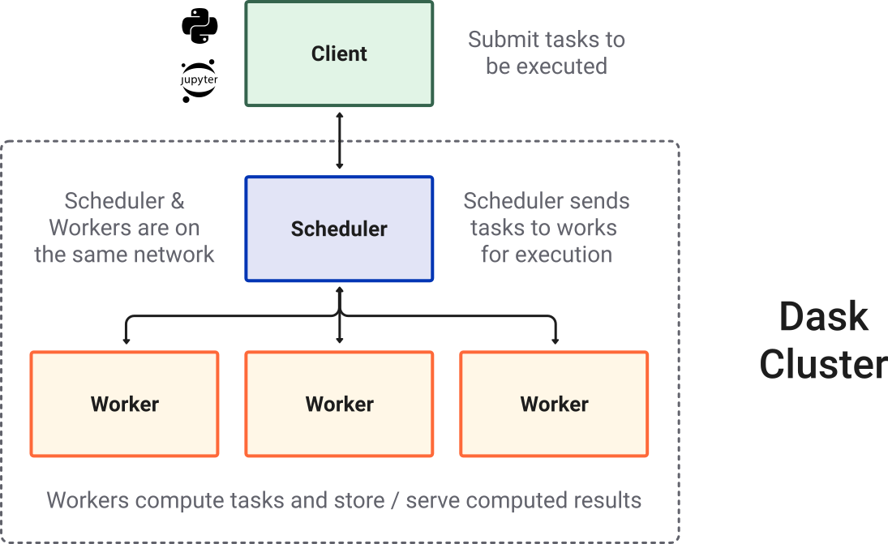
Dask Cluster
Usually, when using Dask, we will be using a distributed scheduler, which exists in the context of a Dask cluster.

Slide 21
Dask Scheduler and Workers
Dask uses a central scheduler to orchestrate the work.
Adding workers can improve performances of complex workloads, however, create overhead that can reduces gains.
Workload will unlikely be perfectly balanced and shared equally among the workers.
Some resources might be not fully exploited or might be idling because of insufficient shared resources (resource starvation).

Slide 22
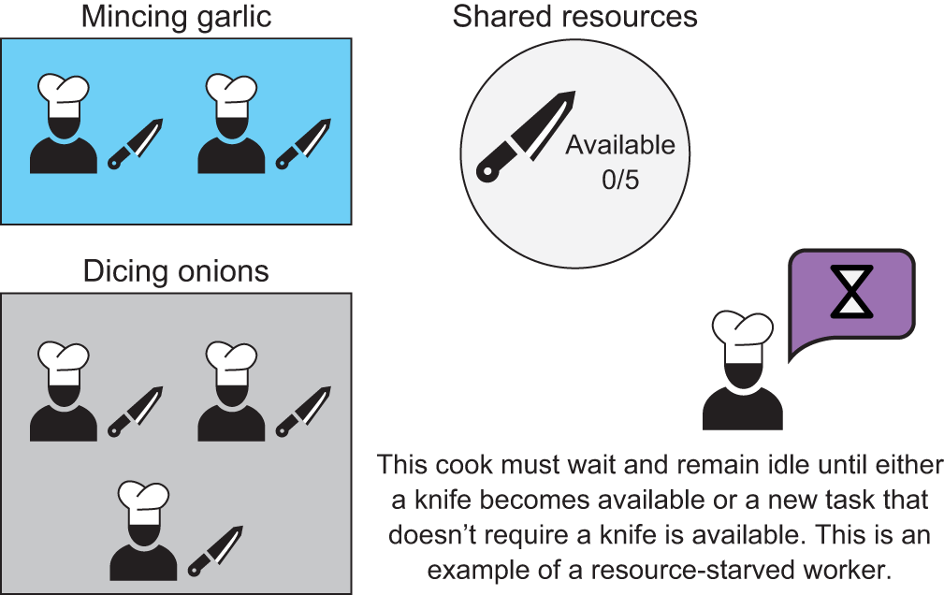
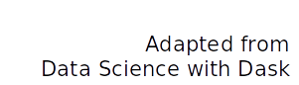
Resources
Scheduler needs to react to avoid bottlenecks

Slide 23
The importance of being lazy
Dask performs a lazy computation
Until we run the method .compute(), Dask only splits the process into smaller logical pieces
Even though the process is defined, the resources assigned and the place where the result will be stored are not assigned
The scheduler assigns them dynamically, allowing to recover from possible worker failure
In case of a failure, Dask reaches a node and repeat the action without disturbing the rest of the process.

Slide 24
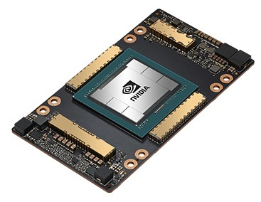
We want more FLOPS/s!
CPUs are designed for more general-purpose tasks and have fewer, more powerful cores that excel at low-latency operations.
GPUs are designed for highly parallel computations, with many-cores optimized for executing the same instructions on many data elements simultaneously (SIMT).
Source: NVIDIA

Slide 25
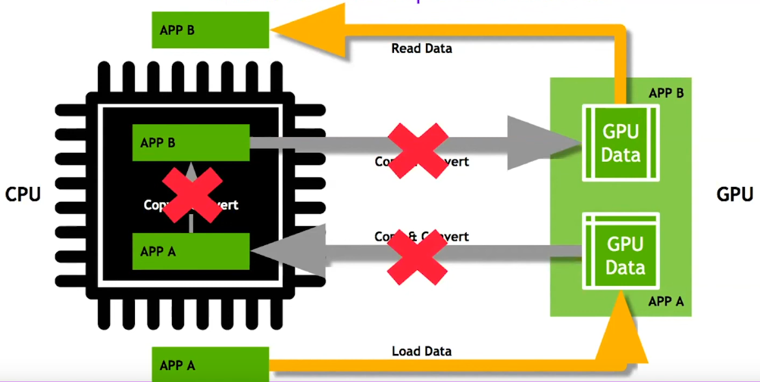
Data Movement and Transformation
Source: NVIDIA RAPIDS
What if we could keep data on the GPU?

Slide 26
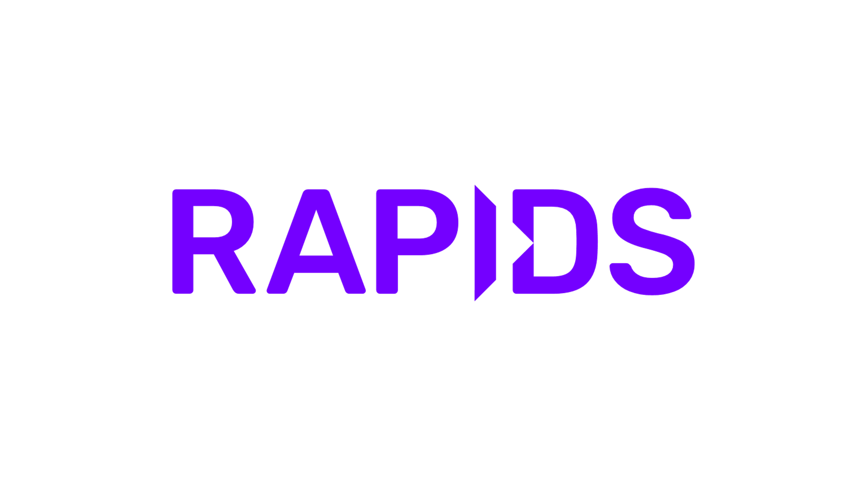
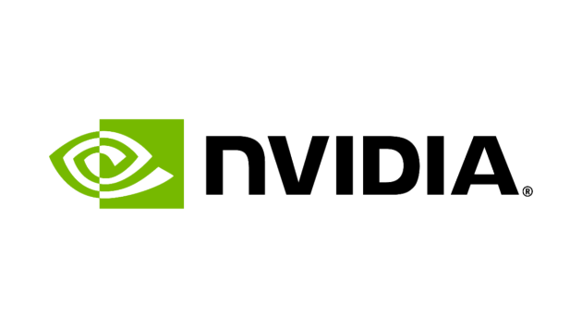
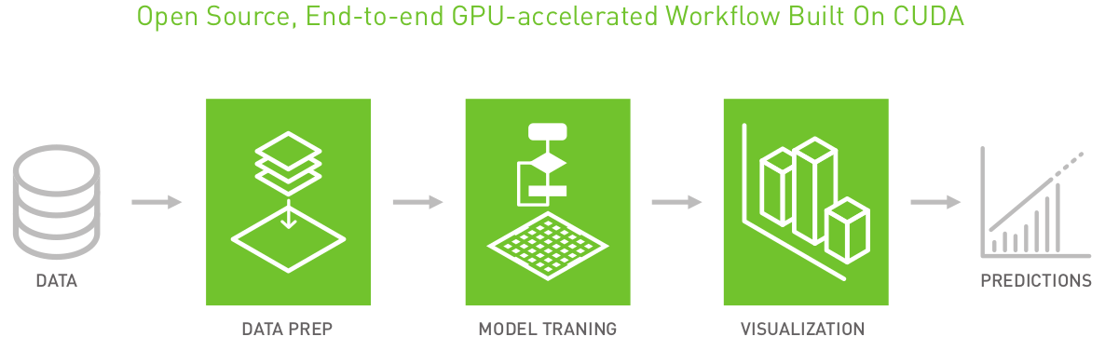
RAPIDS
by is a suite of open-source software libraries and APIs designed to accelerate all data science
Data analysis, modelization and visualization entirely on GPUs
Accelerated machine learning (K-means, PCA, XGBoost, ...)
Source: NVIDIA RAPIDS

Slide 27
Why RAPIDS?
Speed: RAPIDS leverages the power of GPUs to process data, often delivering performance gains of 10x or more compared to traditional CPU-based methods.
Familiarity: Data scientists can continue using familiar tools and workflows, with RAPIDS offering drop-in replacements for many common Python data science libraries.
Ecosystem: RAPIDS integrates with popular data science frameworks like Apache Spark and Dask, making it easy to incorporate GPU acceleration into your existing infrastructure.
Scale: RAPIDS scales seamlessly to handle massive datasets, enabling you to tackle big data problems that were previously impractical or computationally expensive.

Slide 28
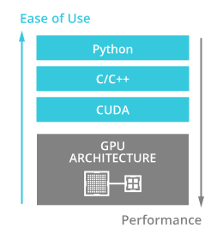
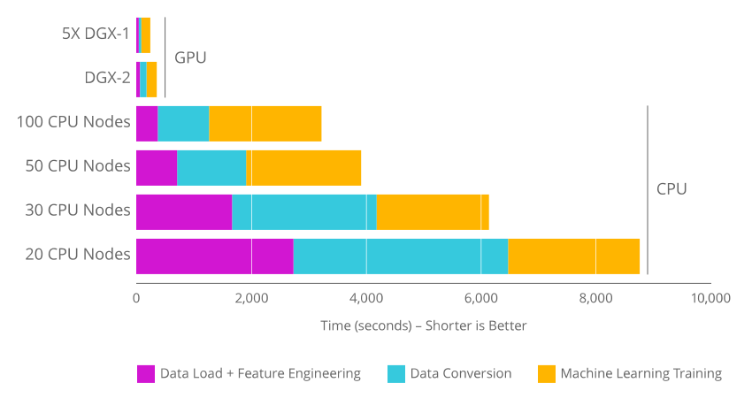
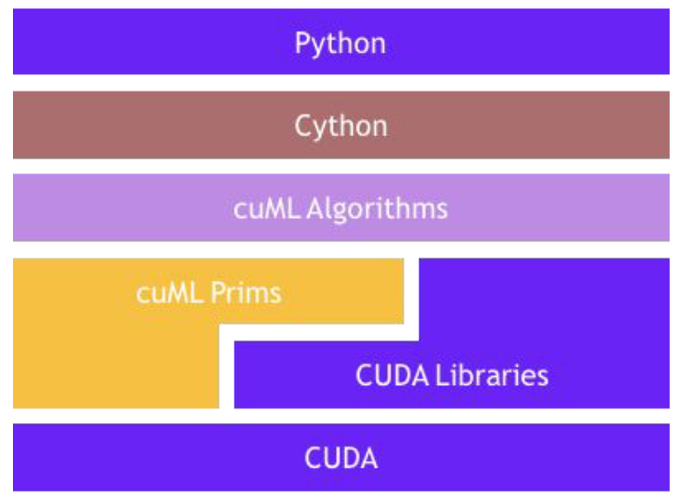
RAPIDS is easy and fast
RAPIDS provides a similar interface to Python libraries like pandas, scikit-learn and NetworkX
RAPIDS becomes advantageous, when the data being manipulated reaches multiple GiBs
Source: Documentation RAPIDS

Slide 29
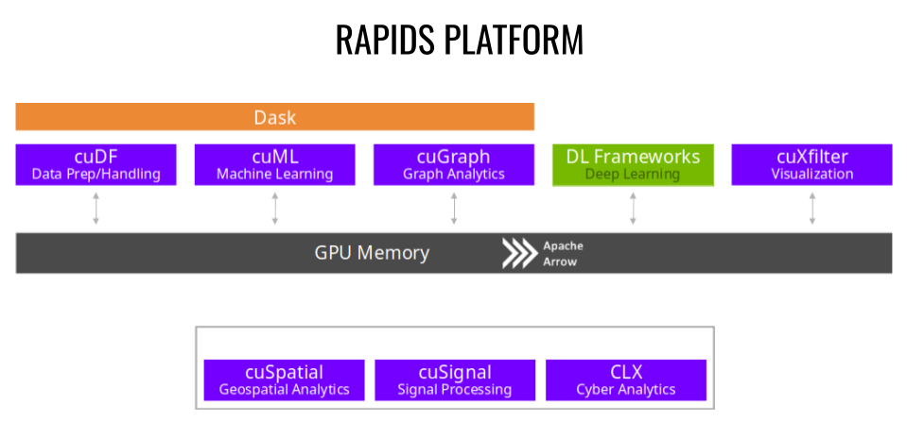
RAPIDS Platform
Source: Documentation RAPIDS

Slide 30
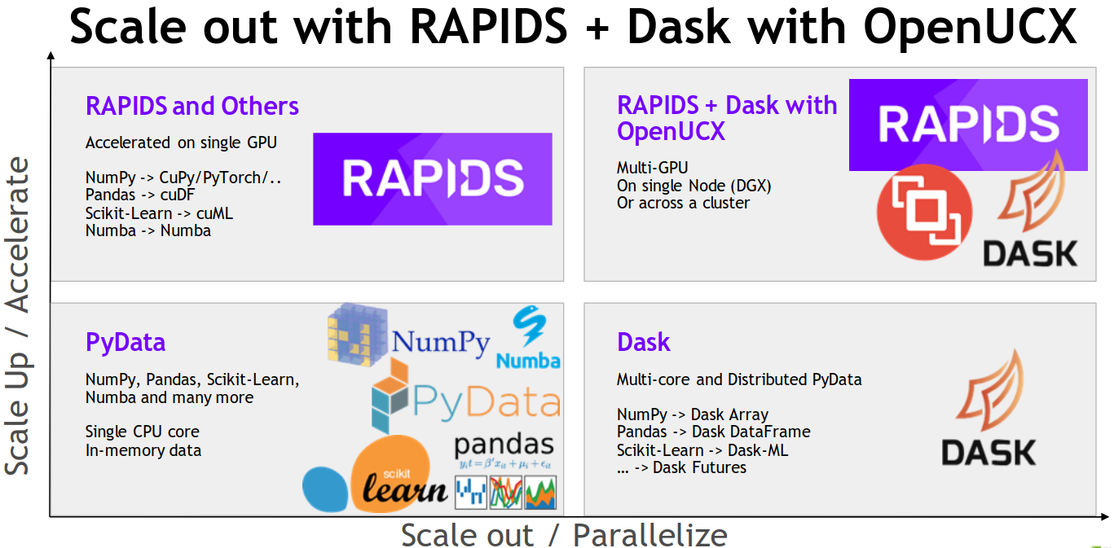
Pandas, Scikit-Learn, Dask, Rapids
Source: Documentation RAPIDS

Slide 31
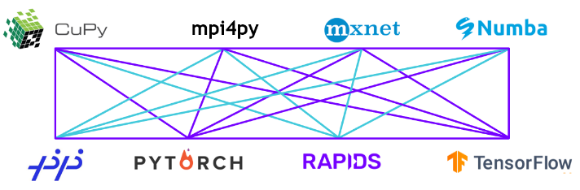
RAPIDS Interoperability
Real-world workflows often need to share data between libraries
RAPIDS supports device memory sharing between data science and deep learning libraries
Keeps data on the GPU avoids costly copies to host memory
Any library that support __cuda_array_interface__ will allow for sharing of memory buffers with RAPIDS

Slide 32
Dask-CUDA
Dask allows users to create a cluster with scheduler and workers
Each Dask-CUDA worker is attached to a dedicated GPU
Dask client can connect to the cluster and distribute data on it
Once the data has been distributed to the workers, the workers can start the distributed operations
Dask-CUDA is an addition to Dask that allows the creation of GPU clusters while optionally configuring networking via the high-performance UCX-Py

Slide 33
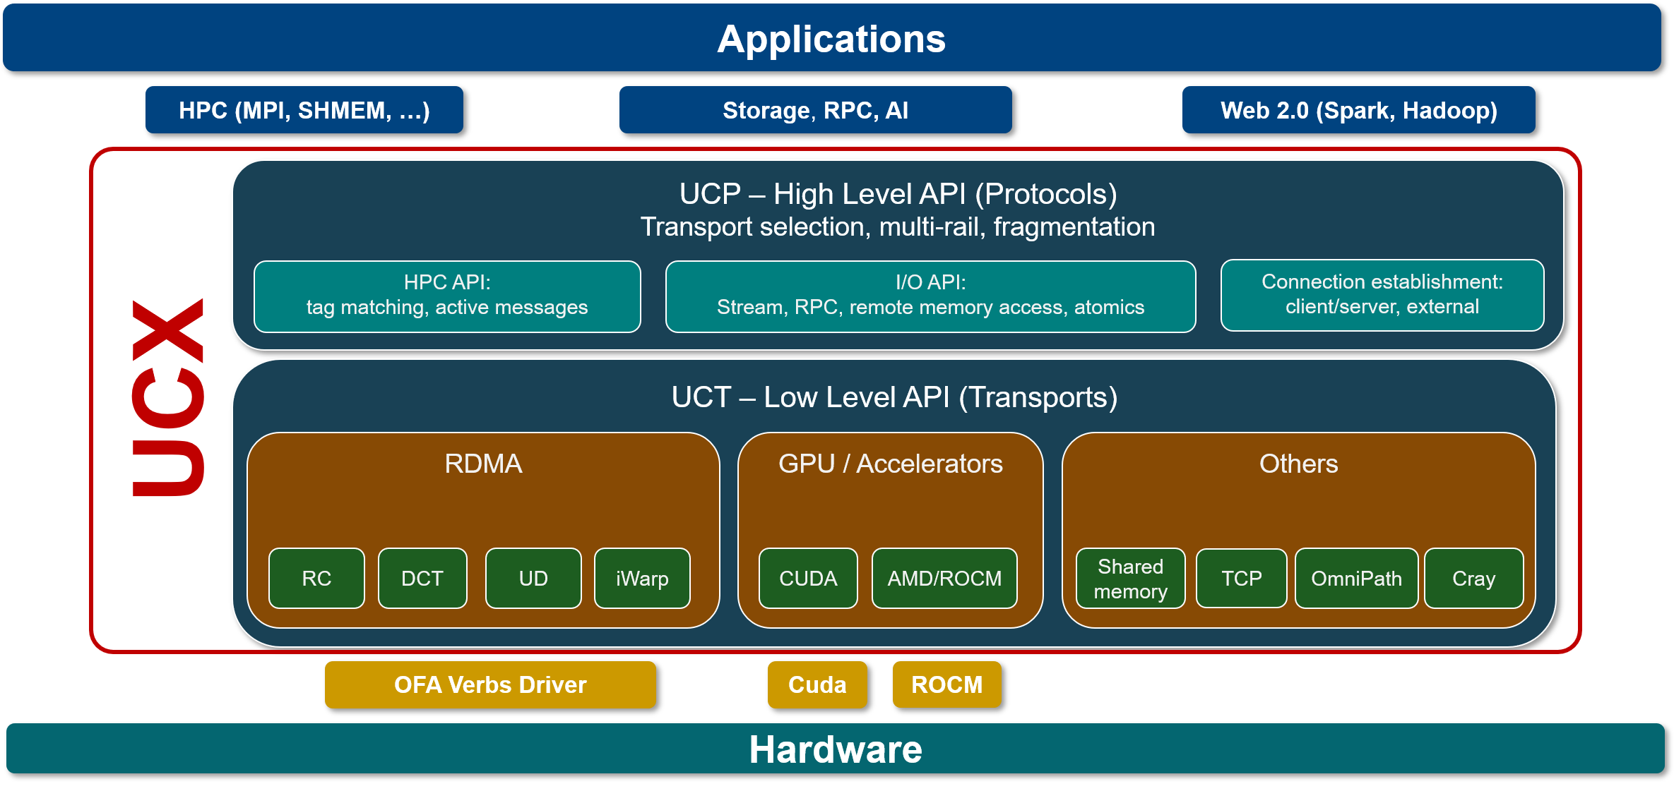
Unified Communication X
UCX is an optimized communication framework for high-bandwidth and low-latency networks
UCX exposes abstract communication primitives that utilize the best of available hardware resources and offload, including RDMA, TCP, GPUs, shared memory, and atomics operations

Slide 34
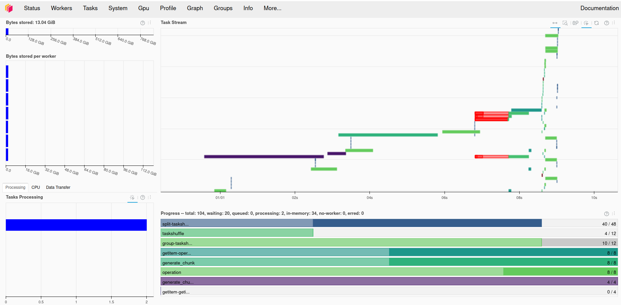
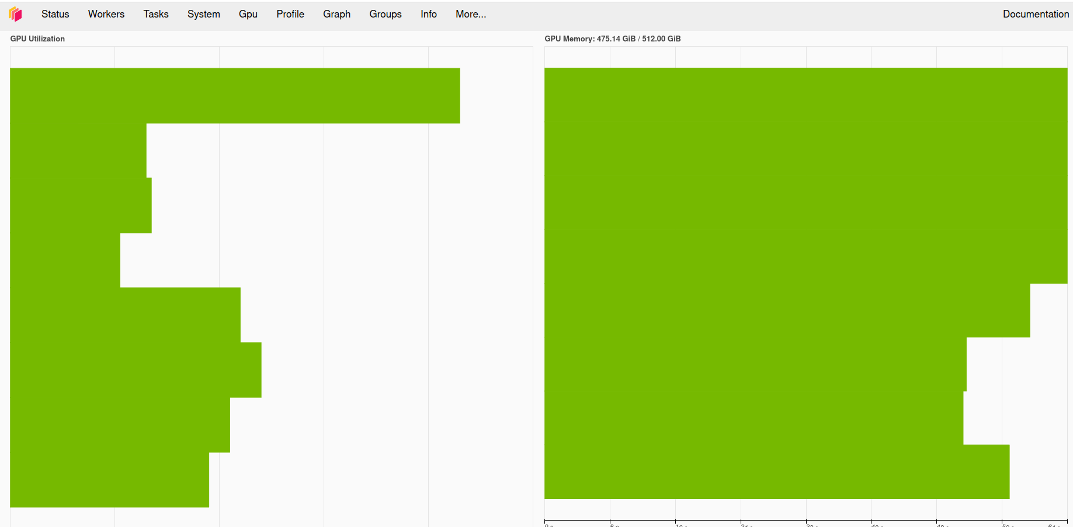
Dask Dashboard Overview
The Dask Dashboard is a web-based monitoring tool that provides real-time insights into the performance and status of a Dask cluster
It helps users understand how tasks are distributed, how resources are utilized, and where potential bottlenecks exist
The dashboard is useful for debugging, performance tuning, and optimization

Slide 35
Install RAPIDS on Leonardo
pip Issues: Infiniband is not supported yet.
Docker Issues: On Leonardo, we use Apptainer and not Docker
Conda Issues: If the Conda is older than 22.11, update to the latest version. This will include libmamba, a Mamba-powered Conda solver to significantly accelerate environment solving. If the Conda installation is version 22.11 or newer, run: $> conda install -n base conda-libmamba-solver $> conda create --solver=libmamba ...
RAPIDS can be used with any conda distribution e.g. miniforge
Also available as module: module load rapids/2023.12

Slide 36
Backup

Slide 37
Structured tabular data and ML
Typically, we deal with structured data starting from csv files, using pandas dataframes to load the datset into memory, and training ML algorithms using scikit-learn or XGBoost.
Unsupervised ML algorithms like PCA, clustering, ... intend to infer an a priori probability distribution that has generated the data.
Supervised ML algorithms like decision trees, k-NN, neural networks, ... intend to infer a conditional probability distribution conditioned on the label of input data.

Slide 38
Type of data
Structured tabular data:
Data tables including discrete data types (numbers,short text,dates) Each column has an attribute, and each row is a single record with associated data values for each attribute. RandomForest and XGBoost excel for structured data
Unstructured data:
Data that doesn’t fit into a data table because its size or nature. Unstructured data doesn’t follow any predetermined rules. Neural networks shine in tasks involving image, text, and speech data, which are difficult for traditional models like XGBoost.

Slide 39
Failure is an option
In case of a failure, Dask reaches a node and repeat the action without disturbing the rest of the process.
There are two types of failures:
work failures: a worker might fail, and we know that we must assign another one to their task. This can slow down the execution. However, it won't affect previous work as data have not been lost.
data loss: accident happens, and we have to start from the beginning. The scheduler stops and restarts from the beginning the whole process.

Slide 40
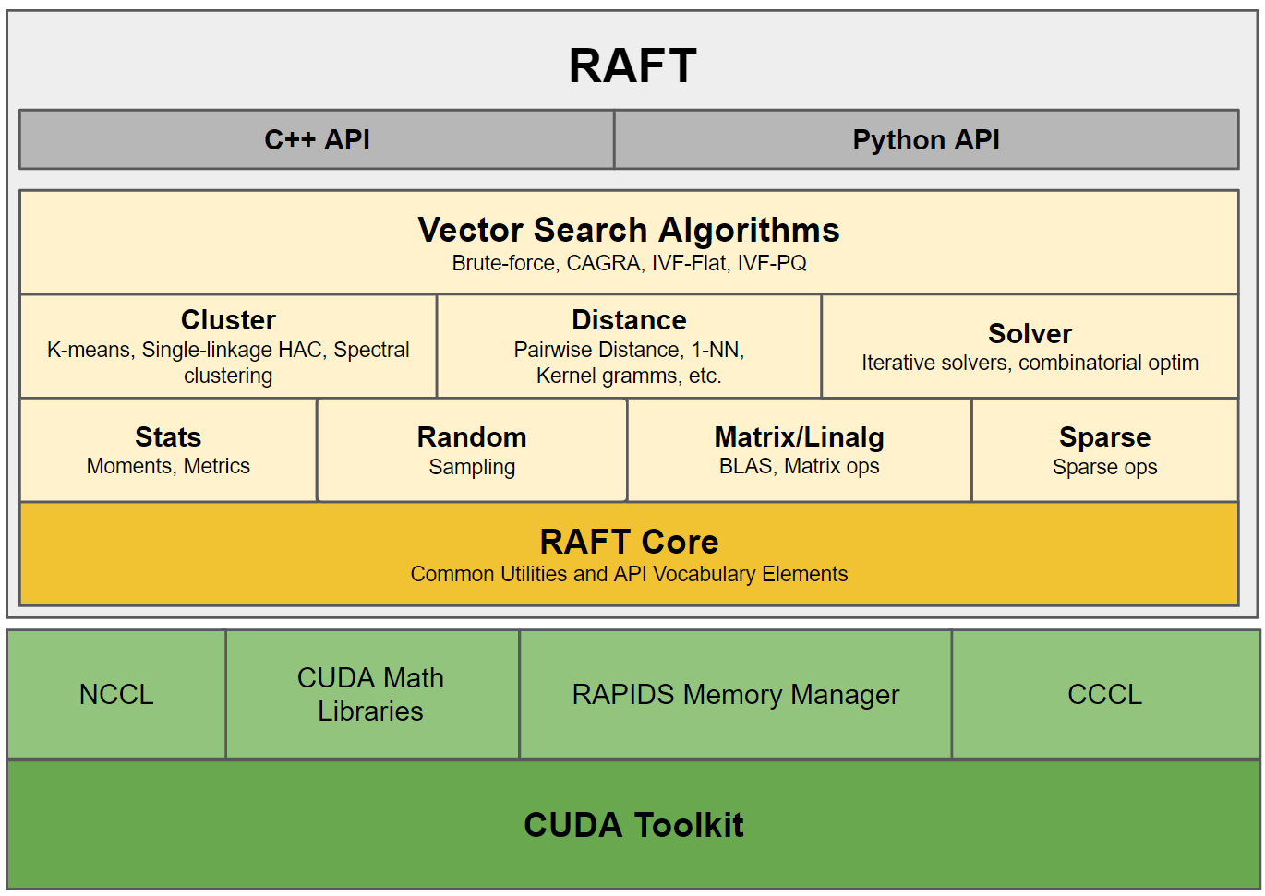
RAPIDS RAFT
RAFT contains fundamental widely-used CUDA-accelerated algorithms and primitives for ML and information retrieval forming building blocks for more easily writing high-performance applications

